Slide 1

TEAM NAME : “A Walk in the Spark ”
ARTIST RECOMMENDATION BASED ON YAHOO DATASET
BIA-678-B : Professor DAVID BELANGER

Slide 2


TEAM NAME : “A Walk in the Spark ”
Malika Thakur
2020-SPRING CS
HOME CITY-CHANDIGARH,INDIA
Jayant Kumar
2020-SPRING CS
HOME CITY-PASIGHAT,INDIA

Slide 3
Presentation Goals
Introduction
Data Visualization and processing
ALS model
Performance analysis
Conclusion and Future work

Slide 4
Approach
Started with - learning basics types
Finding existing papers
Discover techniques for implementation
Implement techniques discovered

Slide 5
Recommendation Algorithms
Content based algorithms:
If you like an item, then you will also like a “similar” item Recommend items to customer x similar to previous items rated highly by x Recommend items that are similar in content to items the user has liked in the past or matched to predefined attributes of the user.
Collaborative filtering algorithms:
We find users who rated movies in common at least one, then calculate the similarity between the users. User is recommended items based on the past ratings of all users collectively
Hybrid algorithms:
In this type both content based, and collaborative algorithms are used.

Slide 6



FLOW OF THE PROJECT
ML LIB
DATA SOURCE
AWS
SPARK
APPLICATION

Slide 7
DATA SET
This dataset represents a snapshot of the Yahoo! Music community’s preferences for various songs. The dataset contains over 717 million ratings of 136 thousand songs given by 1.8 million users of Yahoo! Music services. The data was collected between 2002 and 2006.The users and artists are represented by randomly assigned numeric ids so that no identifying information is revealed. The mapping from artist id’s to artist, is given. There are 2 sets in this dataset. Part one(ydata-ymusic-artist-names-v1_0.csv) is 2.3MB and part 2(ydata-ymusic-user-artist-ratings- v1_0.csv) is 1.1 Gbytes.
Data set link: https://webscope.sandbox.yahoo.com/catalog.php?datatype=r&guccounter=1

Slide 8
VARIABLE DESCRIPTION
VARIABLE | DESCRIPTION
userID | The ID of the user
artistID | The ID of the artist
rating | Rating given by user to artist
VARIABLE | DESCRIPTION
artistID | The ID of the artist
artist | Name of the artist

Slide 9
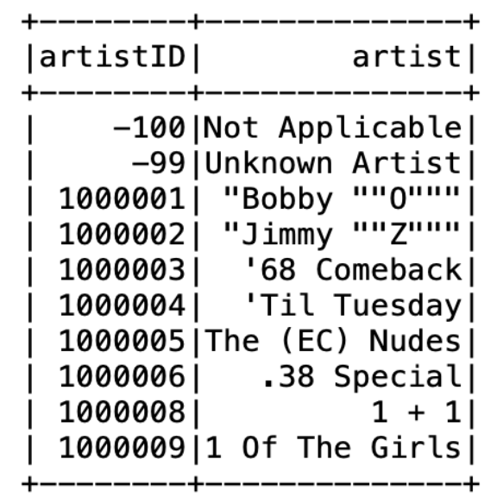
DATA ANALYSIS
Artist mapping data
.
"ydata-ymusic-artist-names-v1_0.csv" contains the artistId and name of each musical artist. The snippet of data set is shown:

Slide 10
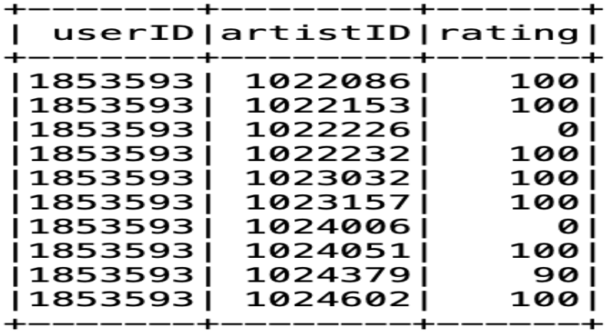
DATA ANALYSIS
User rating data
.
"ydata-ymusic-user-artist-ratings-v1_0.csv" contains user ratings of music artists. It contains 11,557,943 ratings of 98,211 artists by 1,948,882 anonymous users. The format of each line of the file is anonymous_user_id (TAB) artist_id (TAB) rating.
The ratings are integers ranging from 0 to 100, except 255 (a special case that means "never play again"). The snippet of data set is shown:

Slide 11
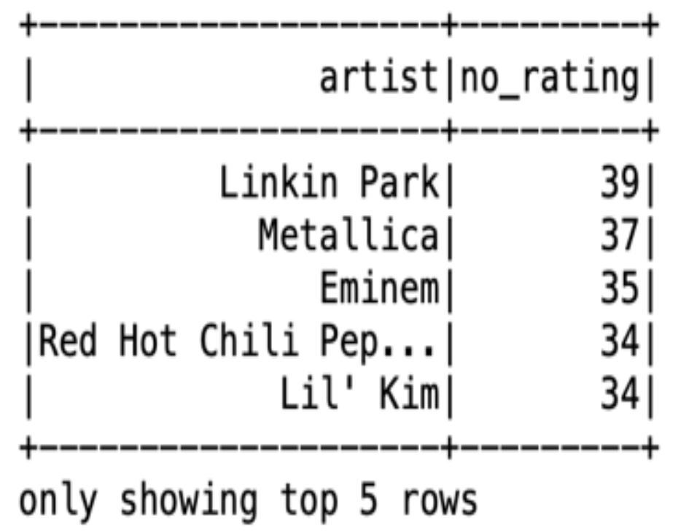
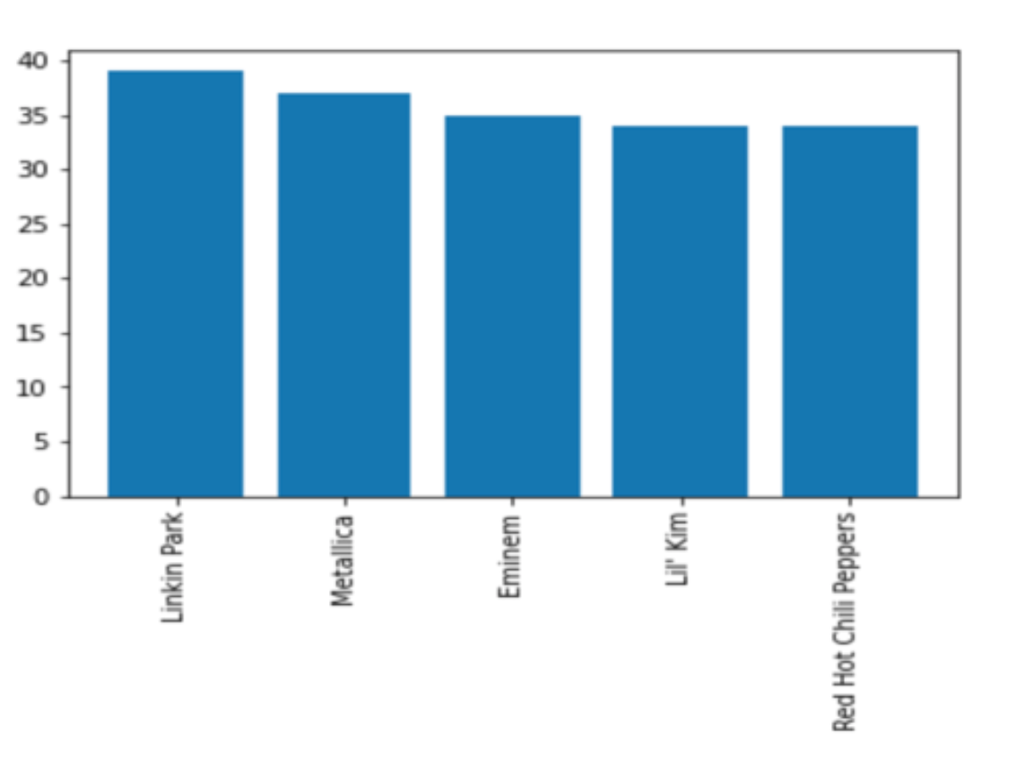
DATA ANALYSIS
Top pop artist which are frequently rated

Slide 12
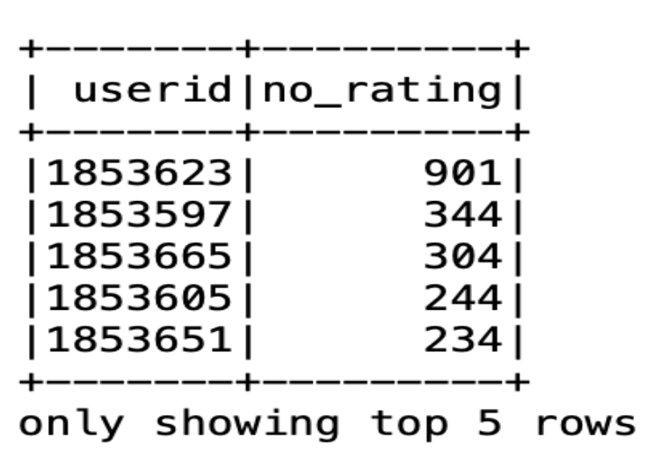
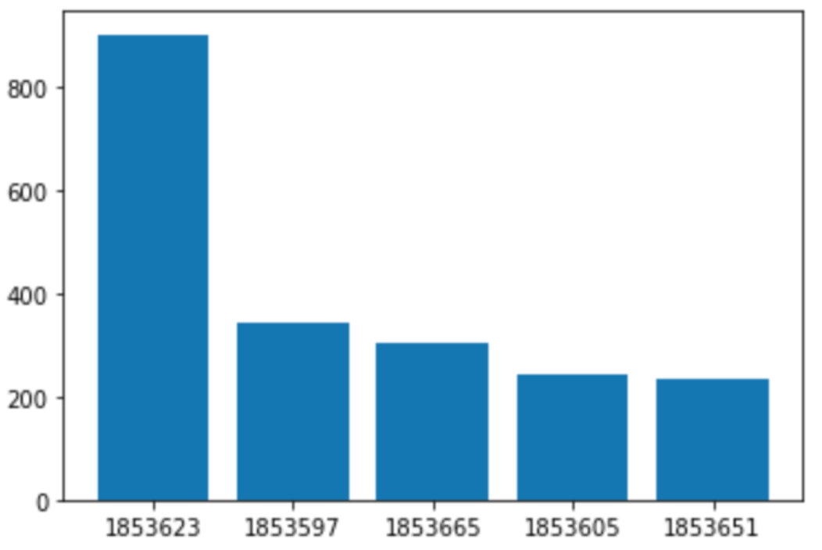
DATA ANALYSIS
Top users frequently giving number of rating:

Slide 13

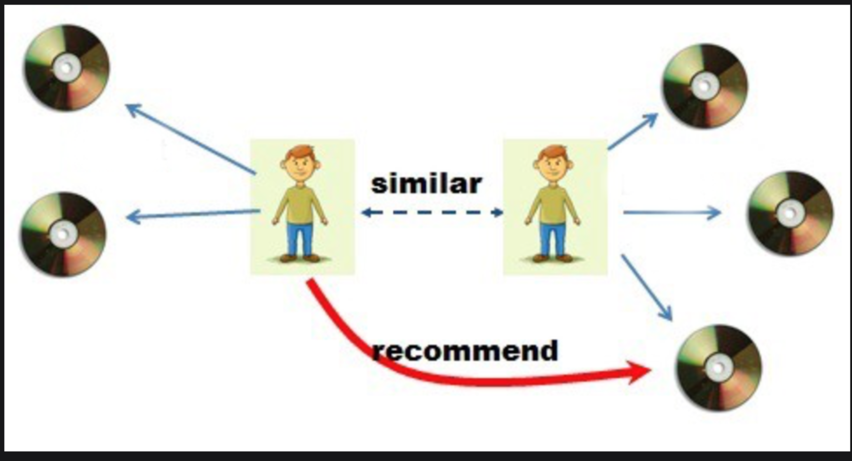
We'll often discuss among friends for recommendations to find a new artist to listen for a good music. Naturally, we have more prominent trust in the suggestions from companions who offer tastes like our own. The concept of Collaborative filtering (CF) can be explained by collecting user feedback in the form of ratings for items in a given domain and analyzing similarities in rating behavior amongst several users in determining how to recommend an item. Pictorial representation is given below:

Slide 14
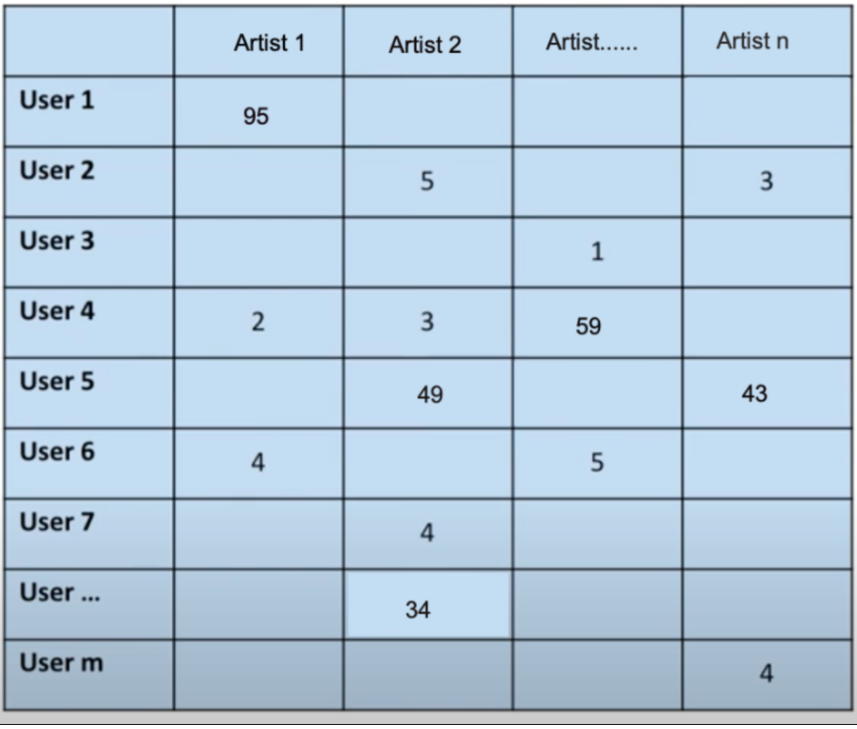
ALS Model
Assume we have a matrix of users and the ratings they accommodated to the artist they have tuned in on the off chance that you'll see a large portion of the matrix is unfilled that is on the grounds that there are extremely numerous artists for anyone to sensibly listen to.

Slide 15
ALS model
One of the major advantages of alternating least square (ALS )is that it works truly well with sparse matrix like this what it tries to do is influence ratings from similar users and fill in all of these clear cells with predictions of how these users would rate these artists. If they somehow happened to watch them the predictions with the most noteworthy qualities at that point become proposals that can be offered to clients
Suppose we have a matrix our ALS we'll take that matrix (m*n)and factor it into two smaller matrices users(U) and artist(P) where if x together produces an approximation of the original matrix R

Slide 16
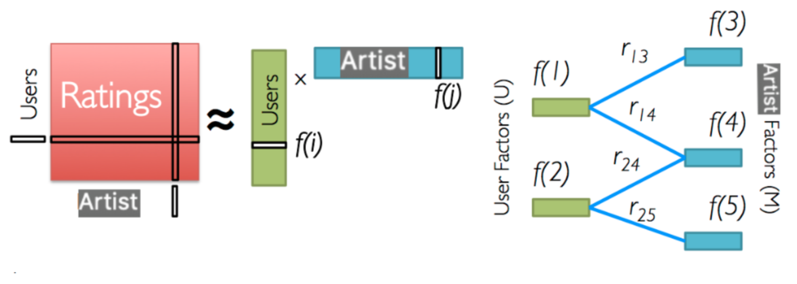
ALS model

Slide 17
ALS Model
ALS decides what values to put into U and P is by first filling them with random numbers.
Calculating the error term according to this error formula and then alternating back and forth between matrix U and matrix P
AlS adjusts the matrices to iteratively decrease the error it continues to alternate between them until the error term is minimized
once this is completed the matrices U and P multiplied back together to get the original matrix R
The magic of ALS is that when they are multiplied back together the blank spaces in the original matrix R are filled with predictions

Slide 18
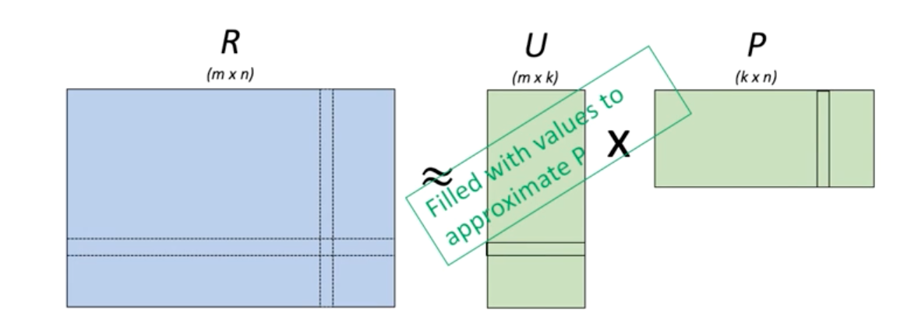
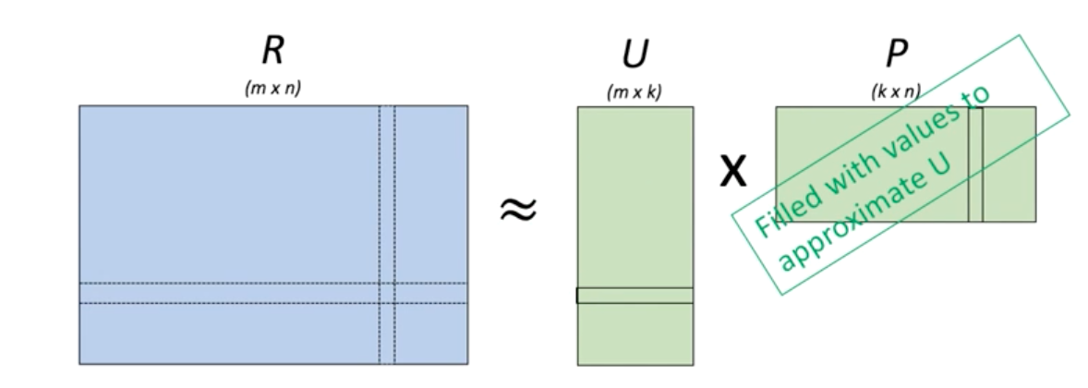
ALS Model

Slide 19
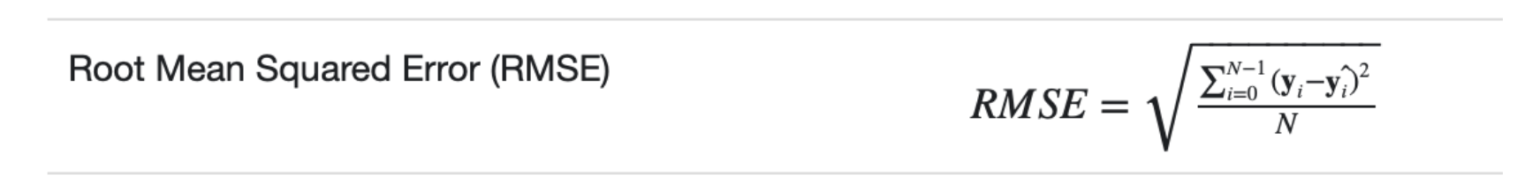
ALS Model
RMSE:
The root-mean-square error (RMSE) is a measure of the differences between values predicted by an ALS the values observed under yahoo music dataset. Formulae is given below to calculate:

Slide 20
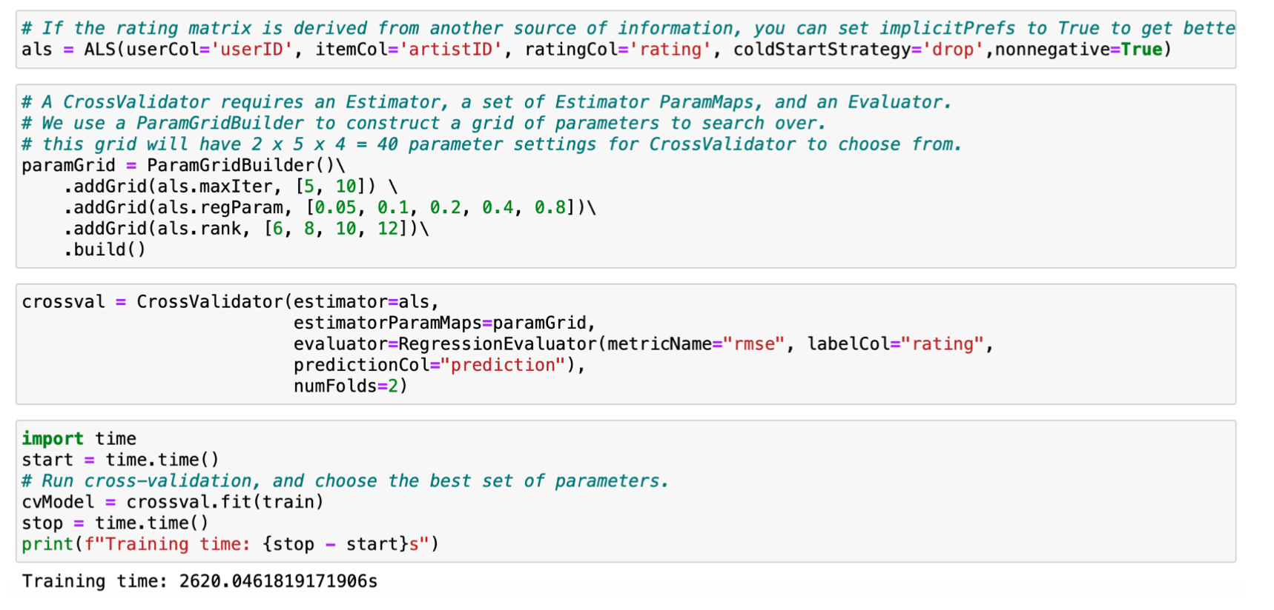
Implementation of ALS model in Spark
Code Snippet:

Slide 21
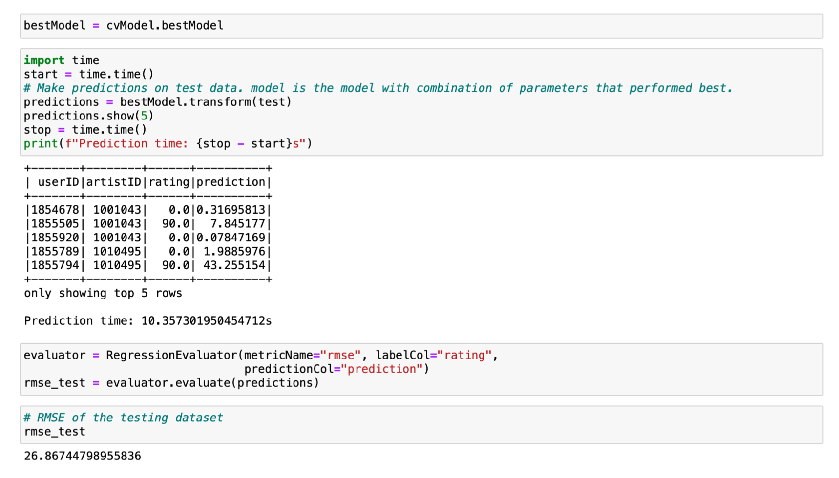
Implementation of ALS model in Spark
Code Snippet:

Slide 22
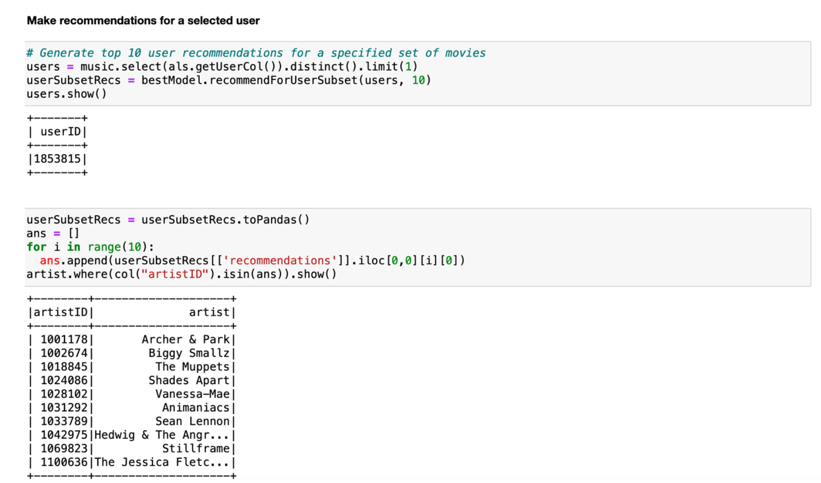
Recommendation of Artists to given user
Code Snippet:

Slide 23
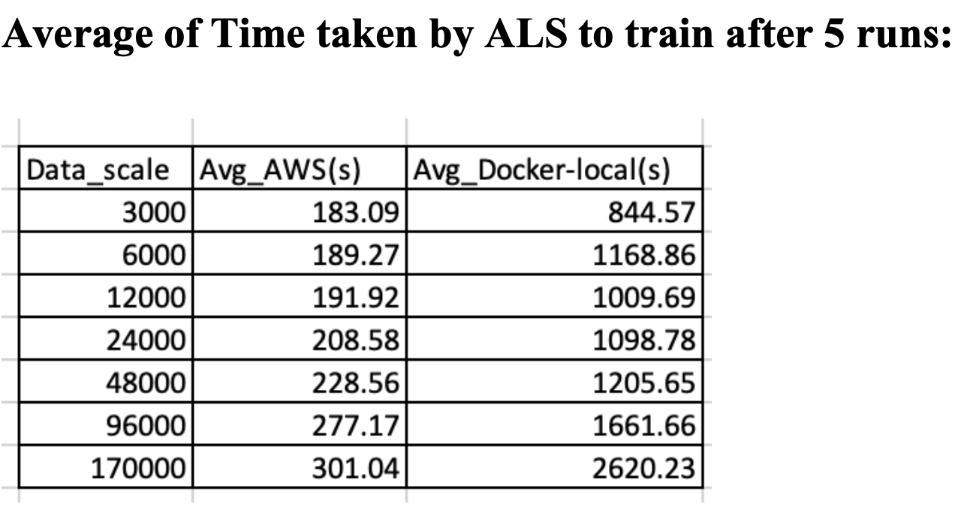
Observation and Records:

Slide 24
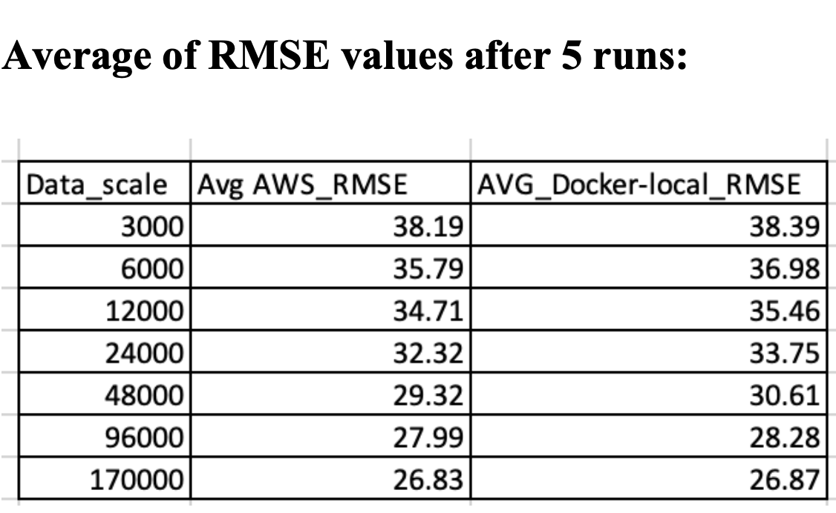
Observation and Records:

Slide 25
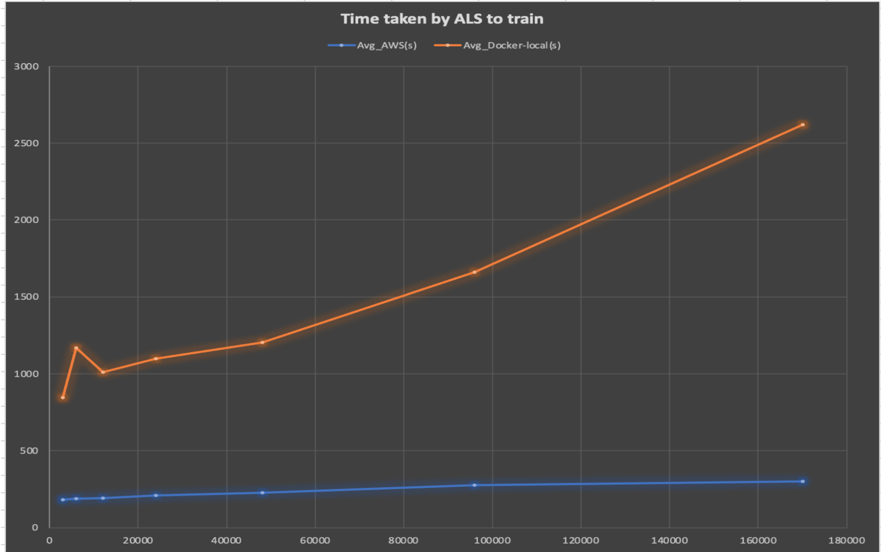
Performance analysis

Slide 26
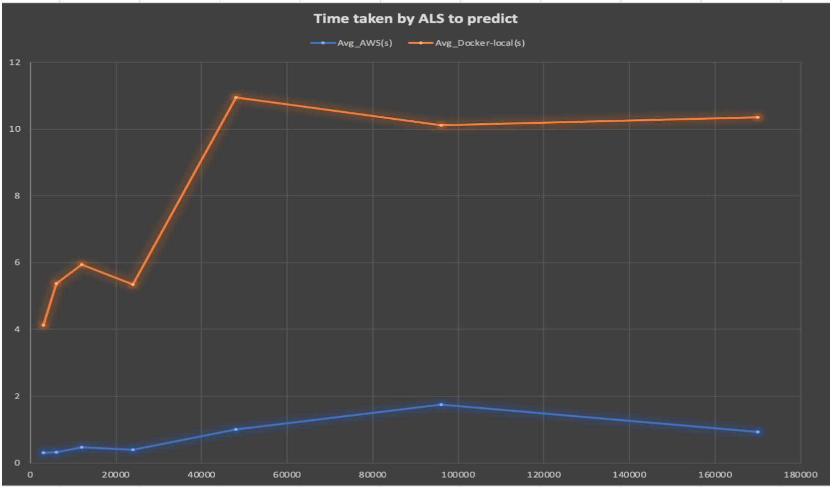
Performance analysis

Slide 27
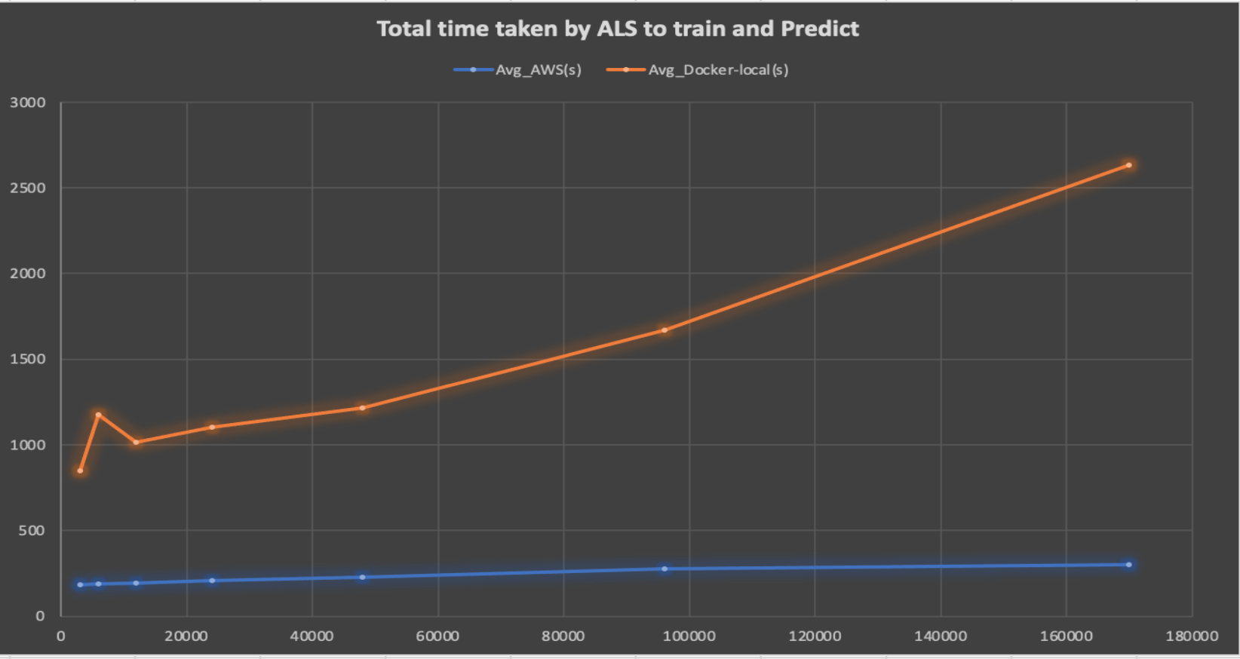
Performance analysis

Slide 28
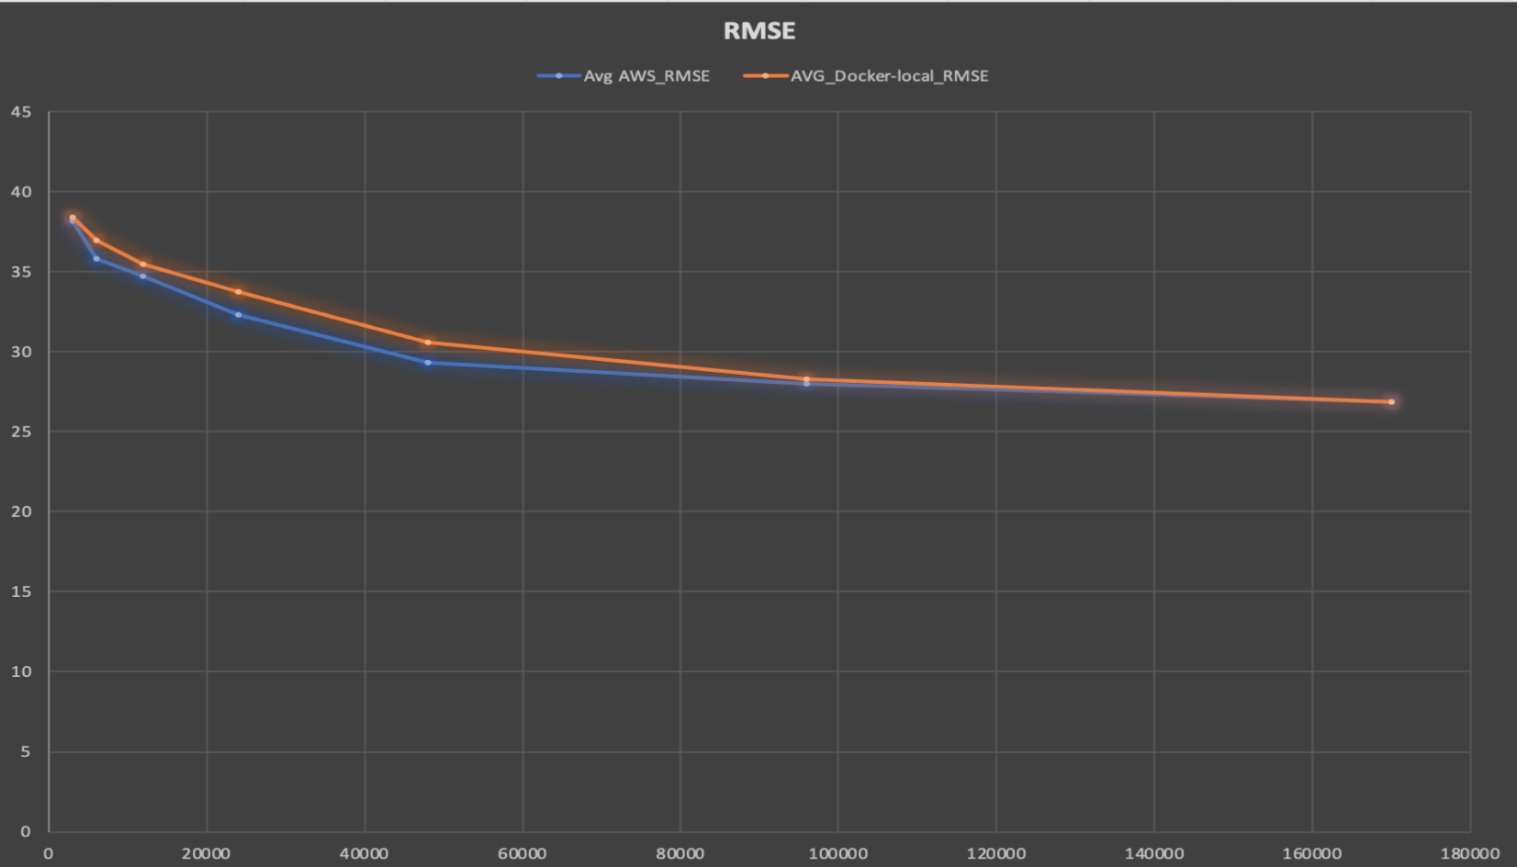
Performance analysis

Slide 29
Discussion on above recommendations and graphs
With the assistance of our metrics, we delivered data that speaks to the correlation between artist predictions dependent on rating and comparable users and the accuracy of the artist proposals. Strangely we found the size of the user history influenced the accuracy of various measurements.
Test users with smaller rating histories would in general behave better accuracy with measurements dependent on artist similarity, while those with bigger rating accounts would in general have better exactness with measurements dependent on user history. Our outcomes show a for the most part low degree of accuracy delivered by the artist recommendations .
The artist recommendation issue is a troublesome one and can be ascribed to the absence of artist recommendations connection between user's rating history and their rating inclinations in the data set.
Accuracy of the ALS increases and RMSE decreases as data scale increases.
We can also see that the cloud platforms AWS performs better as compare to Docker-local from the above time analysis graph.

Slide 30
Limitations
Sparse Data and Lack of additional Information to build-on- From
Cold start
Popularity bias
Human effort

Slide 31

This Project has given us a sharp knowledge of recommendation frameworks. Our outcomes have indicated how we can utilize explicit data (with a rating for every user artist association). This shows that the artist proposal issue is a troublesome one and can be ascribed to the absence of a high relationship between a users' rating history and their artist inclinations in the dataset and in light of the fact that it was computationally wasteful to acquire all the information to run for the model to find a solid connection. We additionally noticed the low accuracy results from both our own work and those from related work, which constrained us to consider approaches to improve overall precision. At last, we concocted a novel technique to give a recommendation system expected to augment the accuracy of our artist to improve overall precision.

Slide 32
Future Works
To work with the implicit dataset and design more precise artist recommender by considering the other factors like number of times user listen to the given artist and the number of hours played by user for given artist. Further design the recommender engine for song recommendation for given user by using Yahoo dataset.

Slide 33

When it Comes to Data, Quality matters more than Quantity!
THANK YOU!

